Slide 1
Research on Prognostic and Health Management Methods for Low-Quality Data Conditions
①
②
③
Remaining Useful Life Prediction based on Intentional Noise Injection and Feature Reconstruction
Multibranch and Multiscale CNN for Fault Diagnosis of Wheelset Bearings Under Strong Noise and Variable Load
Fourier Feature Refiner Network with Soft Thresholding for Machinery Fault Diagnosis Under Highly Noisy Conditions
④
⑤
A Decision Fusion SWT-RF Method for Rolling Bearing Enhanced Diagnosis Under Low-Quality Data
Fusion-Driven Fault Diagnosis based on Adaptive Tuning Feature Mode Decomposition and Synergy Graph Enhanced Transformer for Bearings Under Noisy Conditions
CPS Computational Learning Laboratory
1

Slide 2

Paper 1
Remaining useful life prediction based on intentional noise injection and feature reconstruction
Lei Xiao, Junxuan Tang, Xinghui Zhang, Eric Bechhoefer, and Siyi Ding
Published in: Reliability Engineering and System Safety
Published Time: 2021
CPS Computational Learning Laboratory
2

Slide 3
01
Problem Description
02
Method Design
03
Experiment Results
Contents
04
Conclusion
CPS Computational Learning Laboratory
3
Notes:
主要分为以下四个部分

Slide 4
01
Problem Description
02
Method Design
03
Experiment Results
Contents
04
Conclusion
CPS Computational Learning Laboratory
4
Notes:
首先是问题描述

Slide 5
Problem Description
Motivation
The accurate remaining useful life (RUL) prediction is the foundation of prognostics and health management (PHM). The accuracy of RUL prediction model depends on not only the quality and quantity of degradation feature but also the prediction model.
Challenge
In most of the existing deep-learning based RUL prediction models, noise is considered harmful and has to be removed. Further, the correlation among sensory measurements is ignored. However, noise can boost the prediction performance if judiciously used.
Method
This paper proposes a new RUL prediction method where noise is intentionally added into a long short-term memory (LSTM) network. Additionally, correlation analysis is conducted among the sensory measurements to construct new degradation features as the inputs of the LSTM network.
CPS Computational Learning Laboratory
5

Slide 6
01
Problem Description
02
Method Design
03
Experiment Results
Contents
04
Conclusion
CPS Computational Learning Laboratory
6

Slide 7
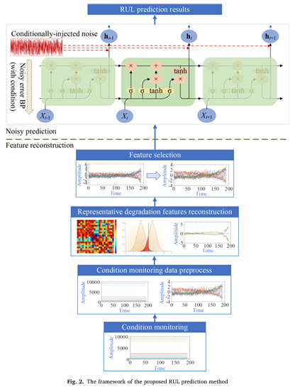
Method Design
CPS Computational Learning Laboratory
7

Slide 8
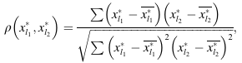
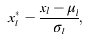
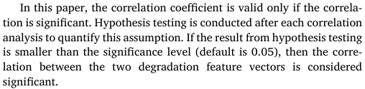
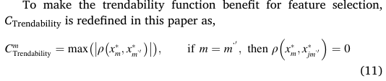
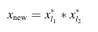
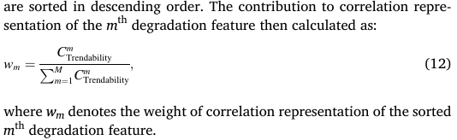
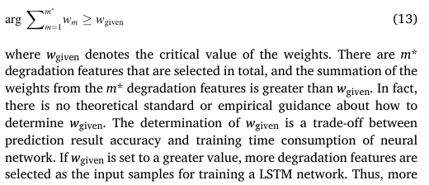


Method Design——Feature reconstruction
moving mean algorithm
Correlation analysis
constant value remove
smoothing
Z-score normalization
construct new degradation features
trendability function
Z-score normalization
select
CPS Computational Learning Laboratory
8

Slide 9
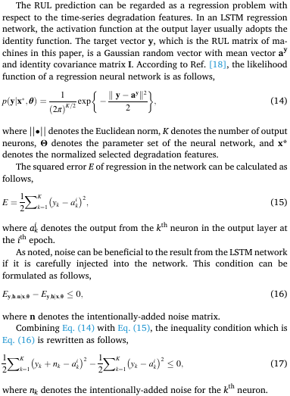
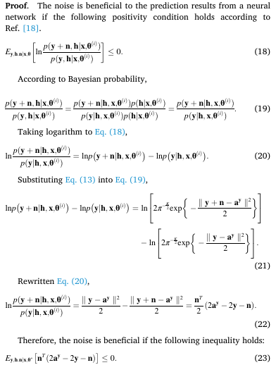
Method Design——Noisy prediction
CPS Computational Learning Laboratory
9

Slide 10

Method Design——Noisy prediction
CPS Computational Learning Laboratory
10

Slide 11
01
Problem Description
02
Method Design
03
Experiment Results
Contents
04
Conclusion
CPS Computational Learning Laboratory
11

Slide 12
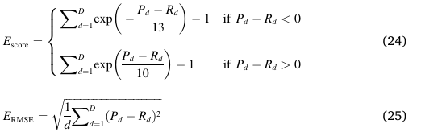
Experiment Results——Metrics
CPS Computational Learning Laboratory
12

Slide 13
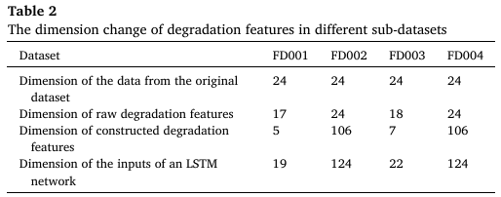
Experiment Results——feature construction and selection
CPS Computational Learning Laboratory
13

Slide 14
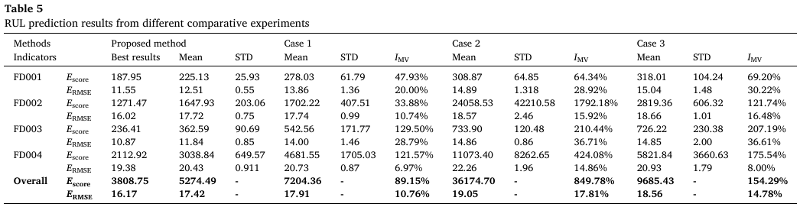
Experiment Results——comparative experiments
Case 1: prediction without noise injection.
Case 2: prediction without feature construction and selection. Case 3: feature construction based on plus operator.
CPS Computational Learning Laboratory
14

Slide 15
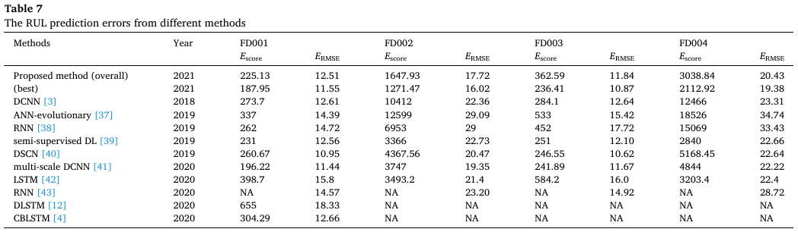
Experiment Results——Comparison with the-state-of-the-art methods
CPS Computational Learning Laboratory
15

Slide 16
01
Problem Description
02
Method Design
03
Experiment Results
Contents
04
Conclusion
CPS Computational Learning Laboratory
16
CPS Computational Learning Laboratory
2
18

Slide 17
Conclusion
In this paper, a new RUL prediction method is proposed. There are two main contributions to the proposed method. Firstly, a series of new degradation features are reconstructed based on the correlation analysis and hypothesis testing, which are conducted among the raw degradation features. However, not all the constructed features are used for training an LSTM network in this paper. A feature is selected according to its trendability representation ability. The other contribution is that the LSTM network is intentionally injected by artificially-generated noise during the training process, which is different from most of the existing deep learning-based RUL prediction methods. The artificially-generated noise is intentionally injected into the output layer of a LSTM network; therefore, the target output is “polluted” and “whiten” by the noise. The noise injection does not decrease the prediction performance, in fact improve the RUL estimation.
CPS Computational Learning Laboratory
17

Slide 18
Paper 2
Multibranch and Multiscale CNN for Fault Diagnosis of Wheelset Bearings Under Strong Noise and Variable Load Condition
Dandan Peng, Huan Wang, Zhiliang Liu, Wei Zhang, Ming J.Zuo, and Jian Chen
Publish Journal: IEEE TRANSACTIONS ON INDUSTRIAL INFORMATICS
Published Time: 2020
CPS Computational Learning Laboratory
18

Slide 19
01
Problem Description
02
Method Design
03
Experiment Results
Contents
04
Conclusion
CPS Computational Learning Laboratory
19

Slide 20
01
Problem Description
02
Method Design
03
Experiment Results
Contents
04
Conclusion
CPS Computational Learning Laboratory
20

Slide 21
Problem Description
Challenge
The critical issue for fault diagnosis of wheelset bearings in high-speed trains is to extract fault features from vibration signals. It is challenging to handle high complexity, strong coupling, and low signal-to-noise ratio of the vibration signals.
Method
This article proposes a multibranch and multiscale convolutional neural network (MBSCNN) that can automatically learn and fuse abundant and complementary fault information from the multiple signal components and time scales of the vibration signals.
CPS Computational Learning Laboratory
21

Slide 22
01
Problem Description
02
Method Design
03
Experiment Results
Contents
04
Conclusion
CPS Computational Learning Laboratory
22

Slide 23
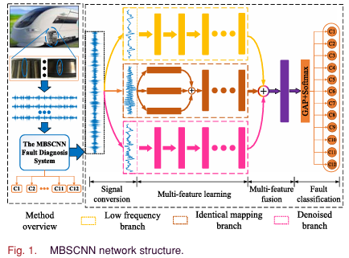
Method Design
CPS Computational Learning Laboratory
23

Slide 24
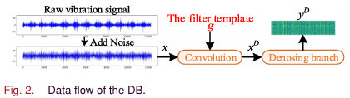
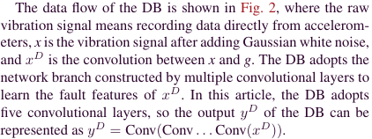
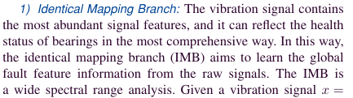
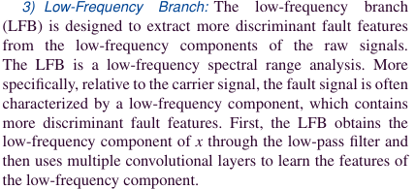
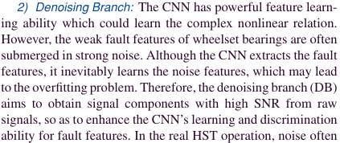

Method Design——Multibranch Learning
CPS Computational Learning Laboratory
24

Slide 25
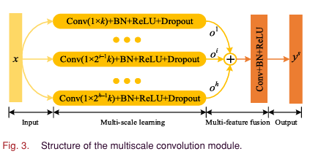
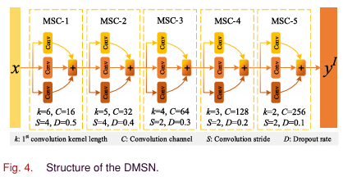
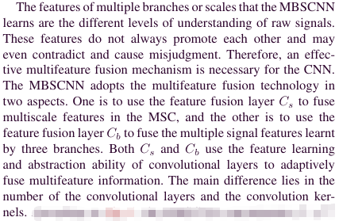
Method Design——Multiscale Learning
CPS Computational Learning Laboratory
25

Slide 26
01
Problem Description
02
Method Design
03
Experiment Results
Contents
04
Conclusion
CPS Computational Learning Laboratory
26

Slide 27
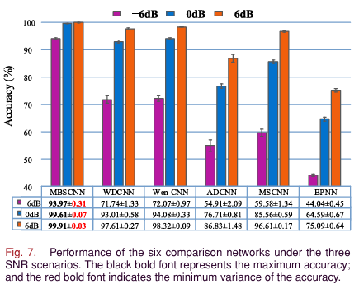
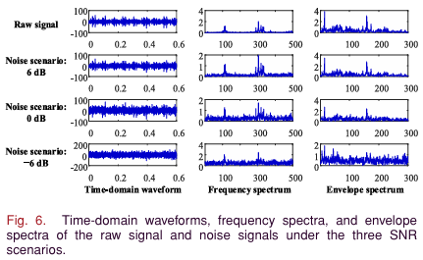
Experiment Results——Robustness Against Noise
CPS Computational Learning Laboratory
27

Slide 28
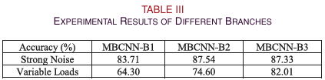
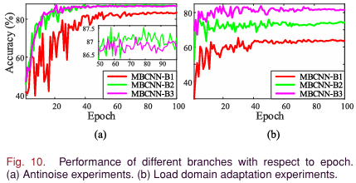
Experiment Results——Necessity of the Multibranch Learning
CPS Computational Learning Laboratory
28

Slide 29
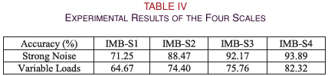
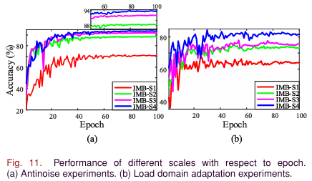
Experiment Results——Necessity of the Multiscale Learning
CPS Computational Learning Laboratory
29

Slide 30
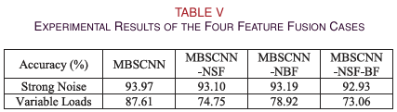
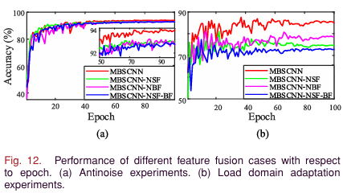
Experiment Results——Necessity of the Multifeature Fusion
CPS Computational Learning Laboratory
30

Slide 31
01
Problem Description
02
Method Design
03
Experiment Results
Contents
04
Conclusion
CPS Computational Learning Laboratory
31
CPS Computational Learning Laboratory
2
18

Slide 32
Conclusion
This article proposed the MBSCNN-based fault diagnosis method to intelligently diagnose the wheelset bearing’s faults from the vibration signals under strong noise and variable load condition. The MBSCNN combines the conventional filtering technology and the multiscale learning and can automatically learn and fuse rich and complementary features from the multiple signal components and time scales, so as to accurately judge the health status of the wheelset bearings.
For the future work, first, we are going to introduce the transfer learning to deal with the problem of speed domain adaptability. Under the variable speed condition, the rotational speed of wheelset bearings changes, which caused a huge change in the distribution of sample feature. Therefore, it is a better choice to use the transfer-learning-based method to learn the domain invariant features of samples under variable speeds. Second, for the HSTs in operation, the number of normal data is far more than that of fault data; therefore, the study on the class imbalance problem is also an important direction.
CPS Computational Learning Laboratory
32

Slide 33
Paper 3
Fourier feature refiner network With Soft Thresholding for Machinery Fault Diagnosis Under Highly Noisy Conditions
Huan Wang, Wenjun Luo, Zhiliang Liu, Junhao Zhang, and Mingjian Zuo
Published in: IEEE INTERNET OF THINGS JOURNAL
Published Time: 2024
CPS Computational Learning Laboratory
33

Slide 34
01
Problem Description
02
Method Design
03
Experiment Results
Contents
04
Conclusion
CPS Computational Learning Laboratory
34

Slide 35
01
Problem Description
02
Method Design
03
Experiment Results
Contents
04
Conclusion
CPS Computational Learning Laboratory
35

Slide 36
Problem Description
Motivation
Machinery fault diagnosis plays an important role in machine prognostic and health management (PHM). Leveraging the abundant data obtained from the Industrial Internet of Things (IIoT), the health states of machines can be effectively recognized, thereby ensuring the safety of the mechanical system.
Challenge
The lack of noise robustness and insufficient frequency domain perception make traditional methods to extract weak fault-related signals difficult under highly noisy conditions in practical industrial scenarios.
Method
This article proposes a PHM framework, a soft thresholding Fourier feature refiner network (Soft-FFRNet), for highly noisy bearing vibration signal diagnosis.
CPS Computational Learning Laboratory
36

Slide 37
01
Problem Description
02
Method Design
03
Experiment Results
Contents
04
Conclusion
CPS Computational Learning Laboratory
37

Slide 38
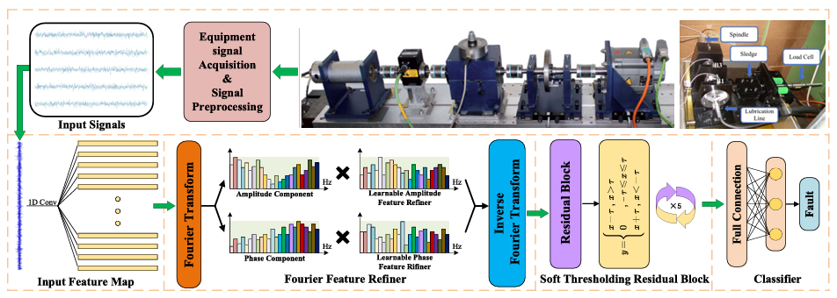
Method Design
CPS Computational Learning Laboratory
38

Slide 39

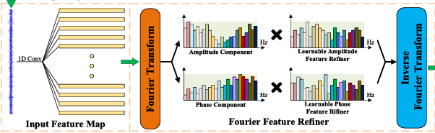
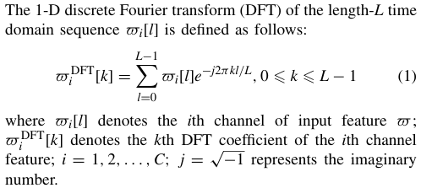
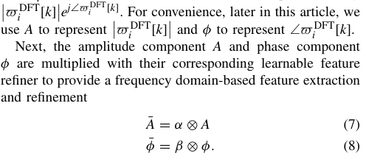
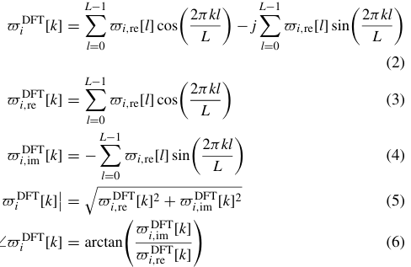
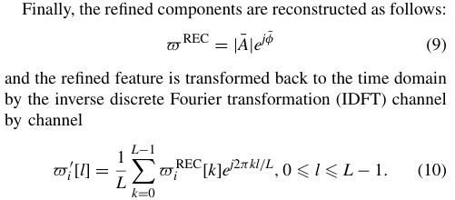
Method Design——Fourier feature refiner network
Selectively extracts and refines the feature in the frequency domain from the perspectives of amplitude and phase.
Input signal
input feature
CPS Computational Learning Laboratory
39

Slide 40
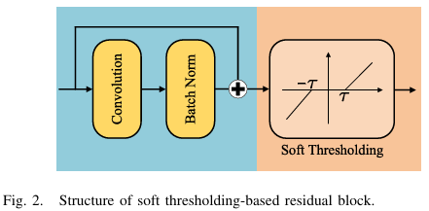
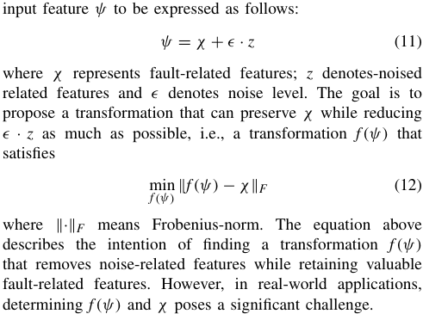
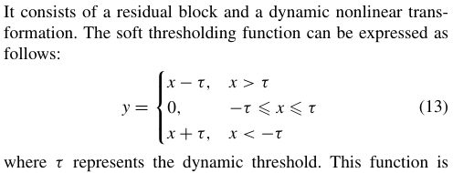
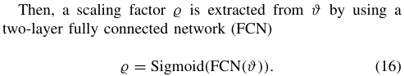
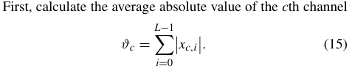
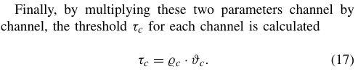
Method Design——Soft thresholding
Utilizes several residual blocks with soft thresholding to effectively improve the noise robustness. The threshold can adaptively change during the training process.
CPS Computational Learning Laboratory
40

Slide 41
01
Problem Description
02
Method Design
03
Experiment Results
Contents
04
Conclusion
CPS Computational Learning Laboratory
41

Slide 42
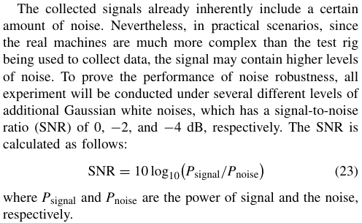
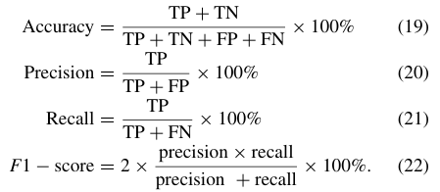
Experiment Results——Metrics
CPS Computational Learning Laboratory
42

Slide 43
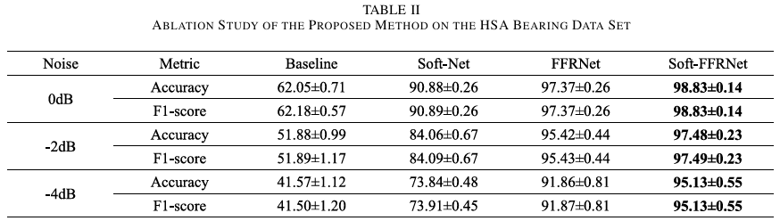
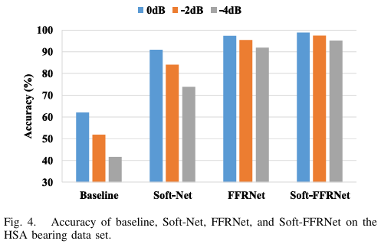
Experiment Results——Ablation Study
CPS Computational Learning Laboratory
43

Slide 44
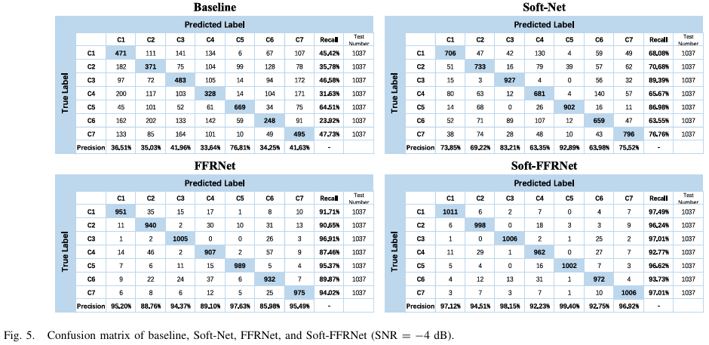
Experiment Results——Ablation Study
CPS Computational Learning Laboratory
44

Slide 45
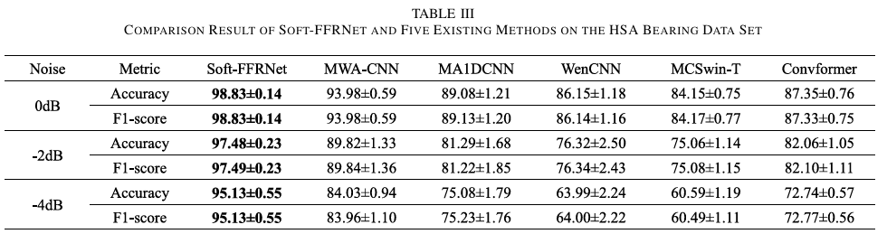
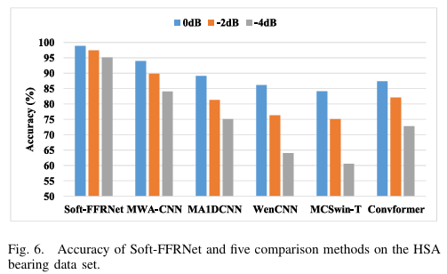
Experiment Results——Comparing Existing Methods
CPS Computational Learning Laboratory
45

Slide 46
01
Problem Description
02
Method Design
03
Experiment Results
Contents
04
Conclusion
CPS Computational Learning Laboratory
46
CPS Computational Learning Laboratory
2
18

Slide 47
Conclusion and future work
The conclusion can be summarized as follows:
The Soft-FFRNet is capable of providing accurate and prompt machinery fault diagnosis for machines in IIoT systems under highly noisy conditions.
The frequency domain learning is useful to improve the noise robustness of the framework.
The soft-thresholding mechanism is beneficial to noise reduction.
To broaden the applicability of our method, future efforts will concentrate on integrating our method with unsupervised domain adaptation techniques. In this manner, the model can transfer the knowledge learned from labeled data sets to unlabeled data sets, which is more commonly encountered in real-life industrial applications due to the high cost of labeling fault types. Moreover, in the future work, we will explore the impact of frequency resolution on the Fourier feature refiner.
CPS Computational Learning Laboratory
47

Slide 48
Paper 4
A Decision Fusion SWT-RF Method for Rolling Bearing Enhanced Diagnosis Under Low-Quality Data
Jiayu Chen, Cuiying Lin, Qinhua Lu, Chaoqi Yang, Peng Li, Pingchao Yu, and Hongjuan Ge
Published in: IEEE TRANSACTIONS ON INSTRUMENTATION AND MEASUREMENT
Published Time: 2024
CPS Computational Learning Laboratory
48

Slide 49
01
Problem Description
02
Method Design
03
Experiment Results
Contents
04
Conclusion
CPS Computational Learning Laboratory
49

Slide 50
01
Problem Description
02
Method Design
03
Experiment Results
Contents
04
Conclusion
CPS Computational Learning Laboratory
50

Slide 51
Problem Description
Motivation
Low-quality data, including insufficient samples and low signal-to-noise ratio (SNR), restrict the effective application of intelligent diagnostic methods based on deep learning.
Method
A rolling bearing enhanced diagnostic method is proposed based on swin-transformer (SWT) and ReliefF (RF) combined with Dempster-Shafer (DS) evidence theory.
CPS Computational Learning Laboratory
51

Slide 52
01
Problem Description
02
Method Design
03
Experiment Results
Contents
04
Conclusion
CPS Computational Learning Laboratory
52

Slide 53

Method Design
CPS Computational Learning Laboratory
53

Slide 54






Method Design——improved SWT
Adaptive deep feature mining of the vibration signal.
CPS Computational Learning Laboratory
54

Slide 55


Method Design——RF-Based Feature Optimization
To enhance the quality of features, RF is introduced to optimize the deep fault features output by the global average pooling layer.
CPS Computational Learning Laboratory
55

Slide 56


Method Design——DS evidence theory based decision fusion
To realize the fusion of different axial signals at the decision level, which enhances the fault knowledge threshold.
CPS Computational Learning Laboratory
56

Slide 57
01
Problem Description
02
Method Design
03
Experiment Results
Contents
04
Conclusion
CPS Computational Learning Laboratory
57

Slide 58


Experiment Results——Ablation Experiment
CPS Computational Learning Laboratory
58

Slide 59



Experiment Results——Ablation Experiment
Comparison of the diagnostic confusion matrices for the three different methods.
SWT-RF-X method
Proposed decision fusion SWT-RF method
SWT-RF-Y method
CPS Computational Learning Laboratory
59

Slide 60


Experiment Results——Comparison With Methods on Different Fusion Levels
CPS Computational Learning Laboratory
60

Slide 61

Experiment Results——Comparisons Under Low-Quality Data Condition
CPS Computational Learning Laboratory
61

Slide 62

Experiment Results——Comparison With Existing Intelligent Diagnostic Methods
CPS Computational Learning Laboratory
62

Slide 63
01
Problem Description
02
Method Design
03
Experiment Results
Contents
04
Conclusion
CPS Computational Learning Laboratory
63
CPS Computational Learning Laboratory
2
18

Slide 64
Conclusion and future work
To realize effective diagnosis under low-quality data, this study proposes a decision fusion method based on SWT and RF to enhance the diagnosis of rolling bearing faults. First, the vibration signals of multiple sensors are directly input to the improved SWT model to adaptively extract their deep feature. This avoids the dependence of the basic model on the prior knowledge of signal processing under low-quality data. Then, the RF is introduced to optimize the extracted deep fault features to improve the expression ability of significant features. In addition, DS decision fusion is integrated to fuse the basic probability assignment of multisensors. Thus, the performance of multiknowledge threshold diagnosis is improved at the decision level. Finally, five comparative experiments are conducted, and the results verify the effectiveness and generalization of the proposed decision fusion SWT-RF method for fault diagnosis of rolling bearing, as well as its superiority over the existing intelligent diagnostic methods.
CPS Computational Learning Laboratory
64

Slide 65
Paper 5
Fusion-driven fault diagnosis based on adaptive tuning feature mode decomposition and synergy graph enhanced transformer for bearings under noisy conditions
Lin Zhu, Jin Wang, Min Chen, and Lintong Liu
Published in: Expert Systems With Applications
Published Time: 2025
CPS Computational Learning Laboratory
65

Slide 66
01
Problem Description
02
Method Design
03
Experiment Results
Contents
04
Conclusion
CPS Computational Learning Laboratory
66

Slide 67
01
Problem Description
02
Method Design
03
Experiment Results
Contents
04
Conclusion
CPS Computational Learning Laboratory
67

Slide 68
Problem Description
Motivation
Bearing fault diagnosis is critical for maintaining the reliability of health monitoring in electromechanical systems.
Challenge
Traditional feature extraction methods often struggle to accurately capture fault information in complex environments. Additionally, given the limitations of single-dimensional feature domains in fully revealing fault information, this study constructs feature topology graphs by mapping spatial phase and time–frequency characteristics, offering a comprehensive representation of fault information.
Method
This paper proposes an adaptive tuning feature mode decomposition (ATFMD) method, based on the intrinsic signal characteristics, to effectively extract robust features. To achieve complementary fusion of fault information within the feature topological graph, this paper proposes the synergy graph enhanced transformer (SGET).
CPS Computational Learning Laboratory
68

Slide 69
01
Problem Description
02
Method Design
03
Experiment Results
Contents
04
Conclusion
CPS Computational Learning Laboratory
69

Slide 70

Method Design——Adaptive tuning feature mode decomposition
CPS Computational Learning Laboratory
70

Slide 71



Method Design——Construction of feature topological graph
CPS Computational Learning Laboratory
71

Slide 72



Method Design——Synergy graph enhanced transformer
CPS Computational Learning Laboratory
72

Slide 73
01
Problem Description
02
Method Design
03
Experiment Results
Contents
04
Conclusion
CPS Computational Learning Laboratory
73

Slide 74

Experiment Results
CPS Computational Learning Laboratory
74

Slide 75


Experiment Results——Ablation analysis
CPS Computational Learning Laboratory
75

Slide 76


Experiment Results——Comparison experiment
CPS Computational Learning Laboratory
76

Slide 77


Experiment Results——Comparison experiment
CPS Computational Learning Laboratory
77

Slide 78

Experiment Results——Comparison experiment
CPS Computational Learning Laboratory
78

Slide 79
01
Problem Description
02
Method Design
03
Experiment Results
Contents
04
Conclusion
CPS Computational Learning Laboratory
79
CPS Computational Learning Laboratory
2
18

Slide 80
Conclusion
In this study, we propose a fusion-driven fault diagnosis method based on ATFMD and SGET, specifically tailored for diagnosing rolling bearing faults in noise-interfered environments. This method is particularly effective in addressing the diagnostic challenges posed by complex and harsh conditions.
In future research, we will focus on enhancing adaptability to composite fault scenarios with limited training samples and lightweight model optimization to reduce computational complexity.
CPS Computational Learning Laboratory
80

Slide 81
Inspiration
Research on enhancing representational learning capabilities under low-quality data conditions, such as transforming noise from performance-degrading to performance-robust factors; and fully exploiting correlations among multi-source data to derive novel features.
CPS Computational Learning Laboratory
81

Slide 82
Thank you for listening

